Slide 1

Akul Kohli
Event Management System
JAVA-BASED CONSOLE APPLICATION

Slide 2

Introduction
A console-based application for comprehensive event management.
Features include event creation, listing, RSVPs, scheduling, notifications, and more.

Slide 3
Core Functionalities
Event creation, listing, and deletion.
Sending reminders.
Viewing and managing attendees.
Main Features:

Slide 4

Event Manager Class
Functionality:
Handles all core operations such as creating, listing, editing, and deleting events.
Manages RSVPs, notifications, and attendee lists.
EventManager

Slide 5
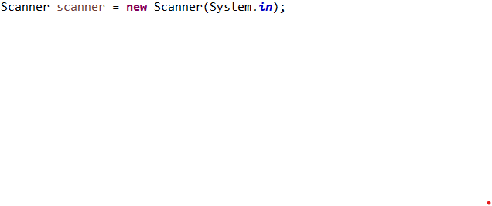
User Input Handling
Purpose:
To interact with the user for various inputs like event details, scheduling options, and attendee information.
Code Snippet:
Scanner Class

Slide 6

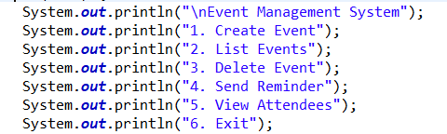
Main Menu
Description:
Provides the user with an interface to select different event-related operations.
Menu Options:
Create Event
List Events
View Event Details
Delete Event
Send Reminder
View Attendees
Exit
Code Snippet:

Slide 7

Creating and Deleting Events
Functionality:
Create Event: Takes input for event name, date, location, and attendee list.
Delete Event: Removes an event from the list based on user selection.
Code Snippet:

Slide 8

Purpose:
Allows managing RSVPs and tracking attendees.
Provides options to view and update attendee information.
RSVP and Attendee Management
Code Snippet:

Slide 9
Functionality:
Sending Reminders and Notifications
Ability to send reminders for upcoming events.
In-app notifications and optional email notifications.
Code Snippet:

Slide 10
purpose:
Displays the list of all created events and allows viewing detailed event information.
Viewing and Managing Events
Code Snippet:

Slide 11

Functionality:
Allows the user to exit the application.
Gracefully closes all resources and terminates the program.
Exit Option
Code Snippet:

Slide 12
Summary:
Conclusion
A versatile event management application supporting event creation, attendee management, and notifications.
Future enhancements may include integration with email services, user activity tracking, and database storage for persistent event data.

